Slide 1
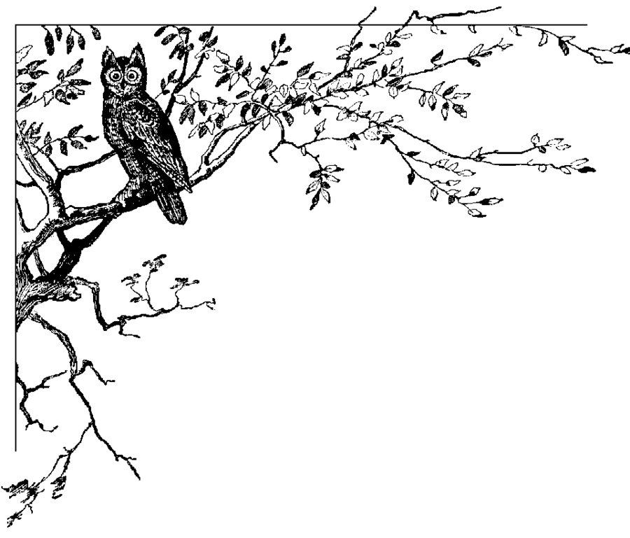
Twitter Bot
Rachael, Nicole, Dionysis, Stuart, Rory

Slide 2





Technical details

Slide 3
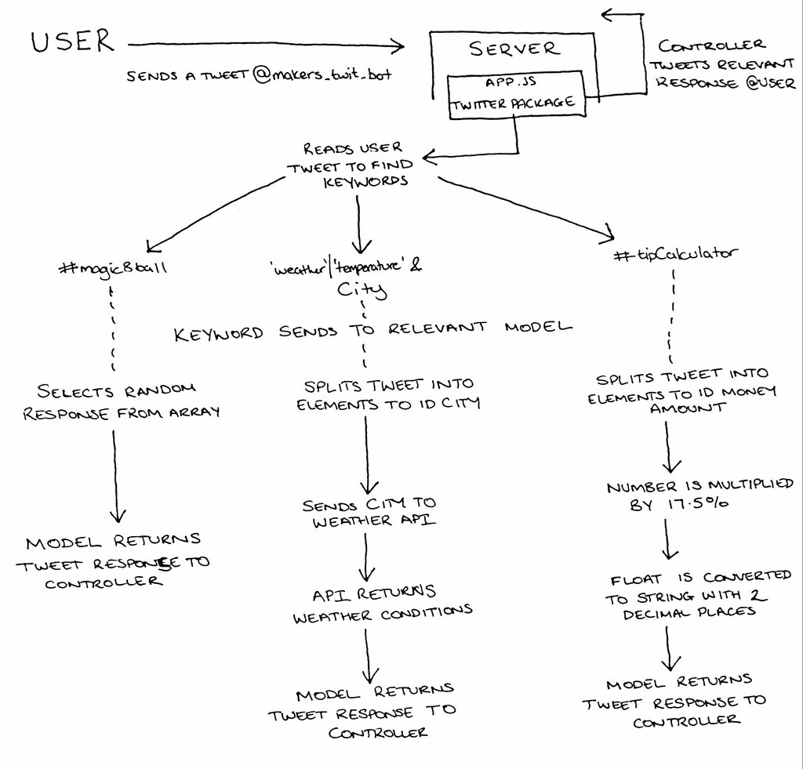

Slide 5
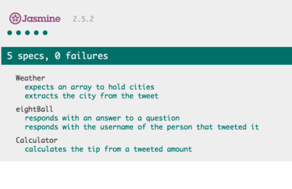
Test coverage

Slide 6
Technical/teamwork struggles
Discovering angularjs was unsuitable
Basic MVP very simple to complete – building out our own complexity
Maintaining focus with creative freedom
Testing modules
Illness!

Slide 7
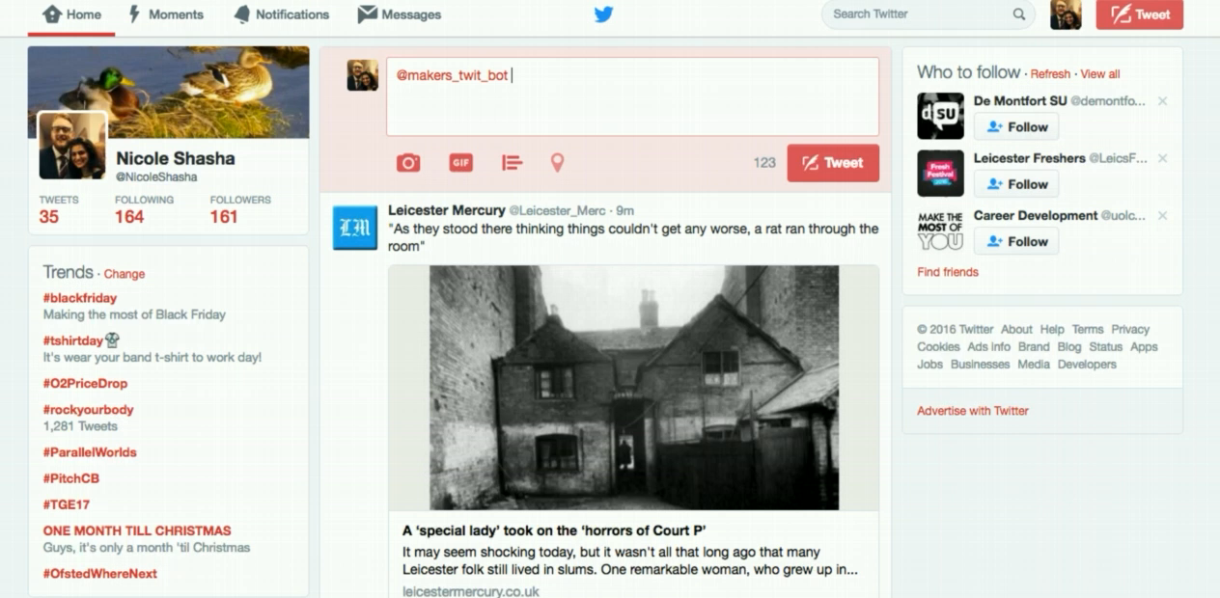
In action

